Slide 1
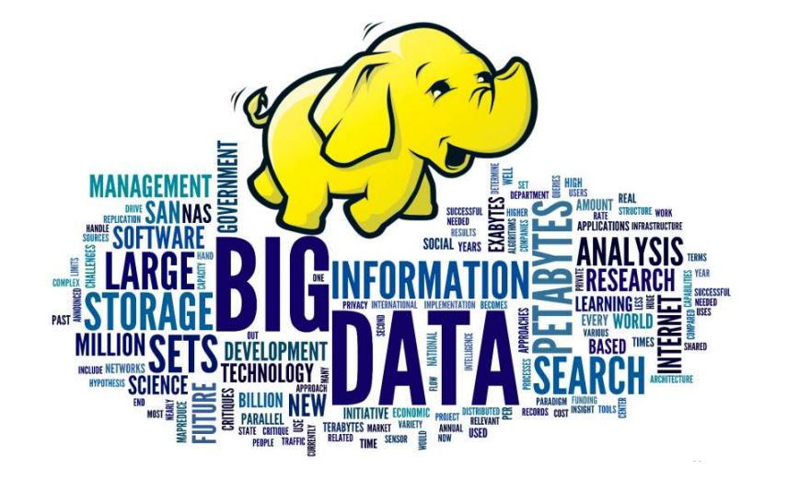
WELCOME TO THE WORLD OF BIG DATA & HADOOP

Slide 2

COMPANY PROFILE
Aptech gives great importance to providing quality education to students. By joining a career course with Aptech, you get:
A wide variety of career, professional, short-term & certification courses designed for the learning & career needs of students, working professionals & others.
Workshops, Events & other activities to encourage student-industry interaction, prepare them for their job interviews & make them industry-ready.

Slide 3
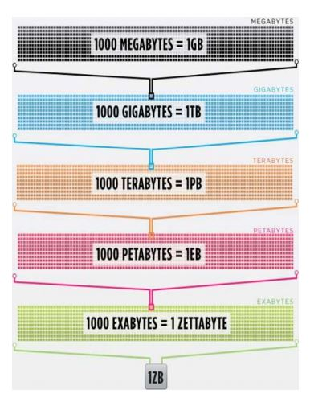
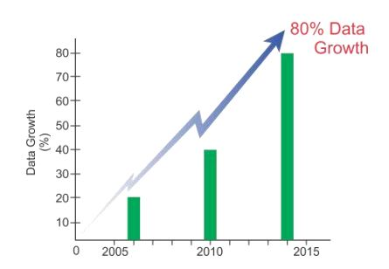
What is Big Data?
Big data is a term used to refer to the study and applications of data sets that are so big and complex that traditional data-processing application software are inadequate to deal with them.
Big data challenges include, data storage, data analysis, search, sharing, transfer, visualization, querying, updating, information privacy and data source. There are a number of concepts associated with big data: volume, variety, velocity.

Slide 4
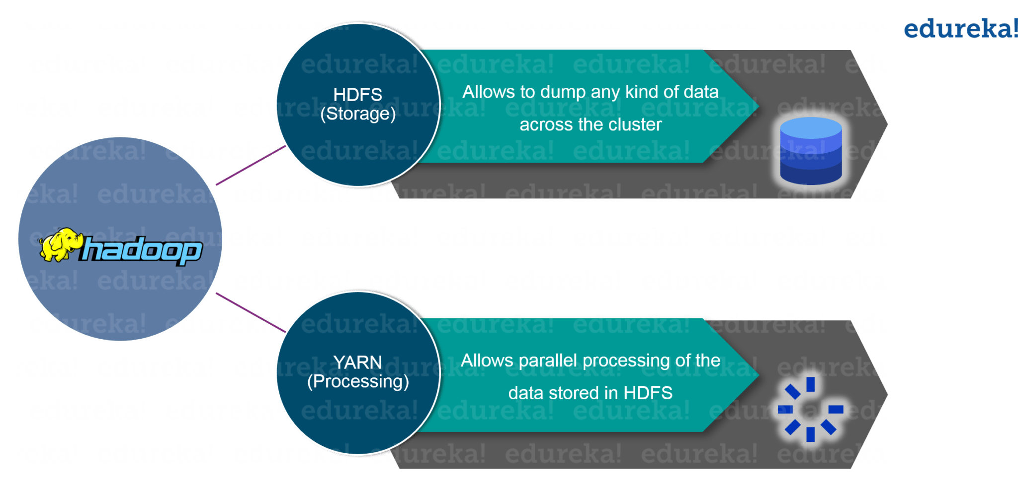
What is Hadoop?
Hadoop is a framework that allows you to first store Big Data in a distributed environment, so that, you can process it parallely. There are basically two components in Hadoop:
The first one is HDFS for storage (Hadoop distributed File System), that allows you to store data of various formats across a cluster. The second one is YARN, for resource management in Hadoop. It allows parallel processing over the data, i.e. stored across HDFS.

Slide 5
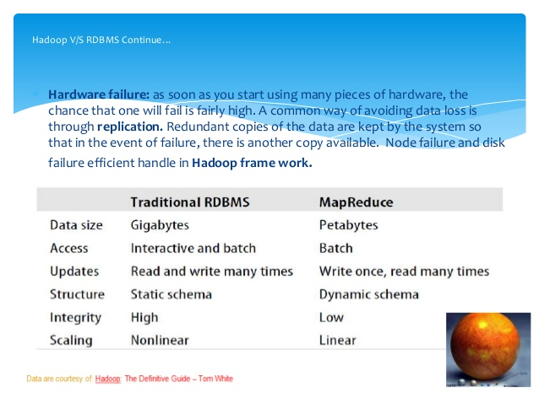

Slide 6
Other software components that can run on top of or alongside Hadoop and have achieved top-level Apache project status include:
Framework | Description
Flume | Software that collects, aggregates and moves large amounts of streaming data into HDFS.
Hive | A data warehousing and SQL-like query language that presents data in the form of tables. Hive programming is similar to database programming.
Oozie | A Hadoop job scheduler.
Pig | A platform for manipulating data stored in HDFS that includes a compiler for MapReduce programs and a high-level language called Pig Latin. It provides a way to perform data extractions, transformations and loading, and basic analysis without having to write MapReduce programs.
Spark | An open-source cluster computing framework with in-memory analytics.
Sqoop | A connection and transfer mechanism that moves data between Hadoop and relational databases.

Slide 7

YOUTUBE DATA ANALYSIS USING HADOOP

Slide 8
Objective
By using Big-data Hadoop technology I am analyzing youtube dataset to find out top 5 categories which are most likely by user, could be most profitable and growing rapidly.

Slide 9
SOFTWARES & FRAMEWORK REQD.
Softwares Used:
Virtual Box - VirtualBox allows you to run more than one operating system at a time. This way, you can run software written for one operating system on another (for example, Linux on Windows or a Mac) without having to reboot to use it.
Winscp - WinSCP is a free and open-source SFTP, FTP, WebDAV, Amazon S3 and SCP client for Microsoft Windows. Its main function is secure file transfer between a local and a remote computer. Beyond this, WinSCP offers basic file manager and file synchronization functionality.
Putty - PuTTY is a versatile terminal program for Windows. It is the world's most popular free SSH client. It supports SSH, telnet, and raw socket connections with good terminal emulation.
Framework Used: Apache Pig

Slide 10
Analysis on the basis of -
Count of a category.
Average user rating(5 star).
Total no. of views.
Maximum views on an video.
No. of rating given to video per 1000 comments.

